Slide 1

Smart Labs Using Raspberry Pi & Machine Learning
Karan Vethody 22106023
Jay Patil 22106020
Vedant Vethekar22106090
Project Guide
Prof. Shraddha Dalvi

Slide 2
Outline
Introduction
Problem Statement
Objectives
Features
Block diagram
Literature survey
Limitations of existing system
Implementation
Uniqueness
Technologies Stack
SDG Goal Alignment
Future work
References

Slide 3
Introduction
Traditional labs waste 60-70% energy on unnecessary lighting when spaces are unoccupied.
Manual control leads to inefficiency and forgotten lights running continuously.
Rising energy costs and environmental concerns demand intelligent solutions.
Need for smart, automated systems that respond to actual occupancy.

Slide 4
Problem statement
College computer labs often suffer from inefficient resource utilization, inconsistent environmental control, and high energy consumption due to static scheduling and manual operation. These labs are typically used by students in unpredictable patterns—varying by time of day, academic calendar, and course requirements. Traditional systems lack the intelligence to adapt to these dynamic usage patterns, leading to:
Computers and peripherals running idle during off-peak hours
HVAC and lighting systems operating uniformly across zones regardless of occupancy
Difficulty in monitoring and optimizing lab usage across multiple rooms or buildings

Slide 5
Objectives
To implement zonal segmentation of computer labs based on layout, usage density, and equipment clusters
To deploy sensors and data collection mechanisms to monitor occupancy, temperature, and device usage
To develop ML models to predict lab usage patterns and automate control decisions
To optimize energy consumption by selectively powering zones based on real-time and forecasted demand
To improve student experience and comfort through adaptive lighting and climate control
To enable centralized monitoring and analytics for lab administrators to assess usage and performance.

Slide 6
Features
Advanced Detection: Real-time human detection using cutting-edge ML models including YOLO and OpenCV for accurate presence identification.
IoT Integration: Seamless integration of Raspberry Pi with camera modules and IoT connectivity for comprehensive system control.
Smart Automation: An Intelligent automated lighting control system that responds instantly to human presence detection.
LED Integration: Energy-efficient LED lighting systems with smart controls and dimming capabilities.
Mobile Control: Dedicated mobile application for remote monitoring, control, and system management.

Slide 7
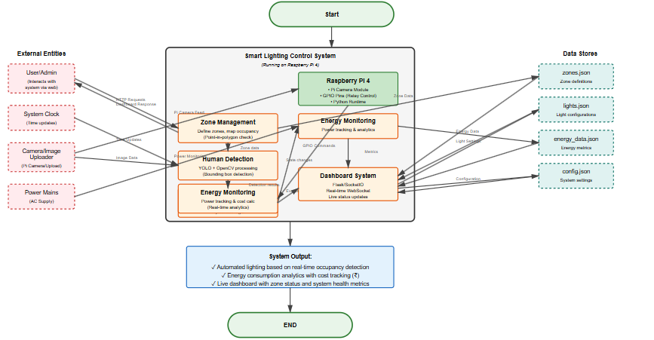
Block Diagram
Fig : System Block diagram

Slide 8
Literature Survey of the existing systems
Smart lab lighting in computer labs uses zonal control grouping lights by desk rows or clusters so only the areas in use are lit, saving energy without compromising comfort for screen work. It combines scheduled lighting scenes (like for lectures or cleaning) with motion sensors and daylight detection to adjust brightness automatically. Optional edge AI can count people without using cameras, protecting privacy. The system keeps light levels between 300–500 lux bright enough for tasks but not harsh and ensures smooth dimming and quick response to changes. If sensors or networks fail, it safely falls back to scheduled lighting. Monthly reports track energy use, sensor errors, and user feedback to show savings while keeping the lab experience smooth and comfortable.

Slide 9
Year | Title | Author | Domain | Algorithm | Dataset | Gap
2025 | Computer Lab Automation System | Sakshi Y. Tupe et al. | Lab Energy Automation | Motion Detection | PIR Sensor Data | No cloud/mobile integration; basic detection only
2024 | Remote Laboratory for IoT Development and Learning Analytics | K. Trikoupis et al. | Remote IoT Education | Node-RED Workflow | LMS-integrated IoT logs | Limited tactile experience; latency issues; scalability challenges
2024 | Wireless Smart Lighting System | Mohankumar A. et al. | Campus Infrastructure | Sensor-based LED Control | Wireless Sensor Logs | Centralised setup; poor modularity for decentralised labs
2023 | IoT-Based Smart Laboratory System | R. Sharma et al. | Lab Automation | Rule-based Automation | Sensor Logs (Lights/Fans) | No ML integration; lacks adaptive intelligence
2023 | ML-Enabled Smart Industrial Automation | A. Mehta et al. | Industrial IoT | SVM, Decision Trees | Industrial IoT Sensor Data | Focused on industry; lacks educational lab context

Slide 10
Year | Title | Author | Domain | Algorithm | Dataset | Gap
2023 | IoT + ML Smart Systems Overview | N. Desai et al. | Smart Systems | Hybrid ML Models | Aggregated IoT datasets | Broad overview; lacks implementation specifics for labs
2022 | Secured Smart Automation System for Computer Labs | P. Sudhakaran et al. | Lab Safety Automation | IoT Sensor Fusion | Motion, Fire, Intrusion Sensor Logs | Privacy concerns; cloud dependency; false alarms
2022 | Smart Classroom Automation Using IoT | M. Ramesh et al. | Educational Automation | Decision Trees, MQTT | Decision Trees, MQTT | Classroom-focused; lacks lab-specific energy optimization
2021 | AI-Based Smart Lab Monitoring System | T. Kulkarni et al. | Lab Monitoring | YOLOv3, OpenCV | Custom Lab Video Dataset | Limited scalability; lacks mobile integration and analytics
2020 | Smart Lab with Automated Access | S. Prathima et al. | Access Control | Face Recognition (AWS) | USB Camera + AWS Rekognition | Limited to access control; no energy optimization

Slide 11
Limitations of the existing systems
Limited Intelligence: Many systems rely on basic motion sensors or rule-based automation, lacking adaptive machine learning for accurate human detection.
Scalability Challenges: Centralized architectures and complex installations hinder deployment across multiple labs or institutions.
Cloud Dependency & Privacy Risks: Systems using cloud-based services (e.g., AWS) raise concerns over data privacy, latency, and network reliability.
Lack of Mobile/Cloud Integration: Several solutions do not support remote access or mobile control, reducing flexibility and user engagement.
False Triggers & Sensor Inaccuracy: PIR and basic sensors often produce false positives, leading to inefficient energy usage and unreliable automation.

Slide 12
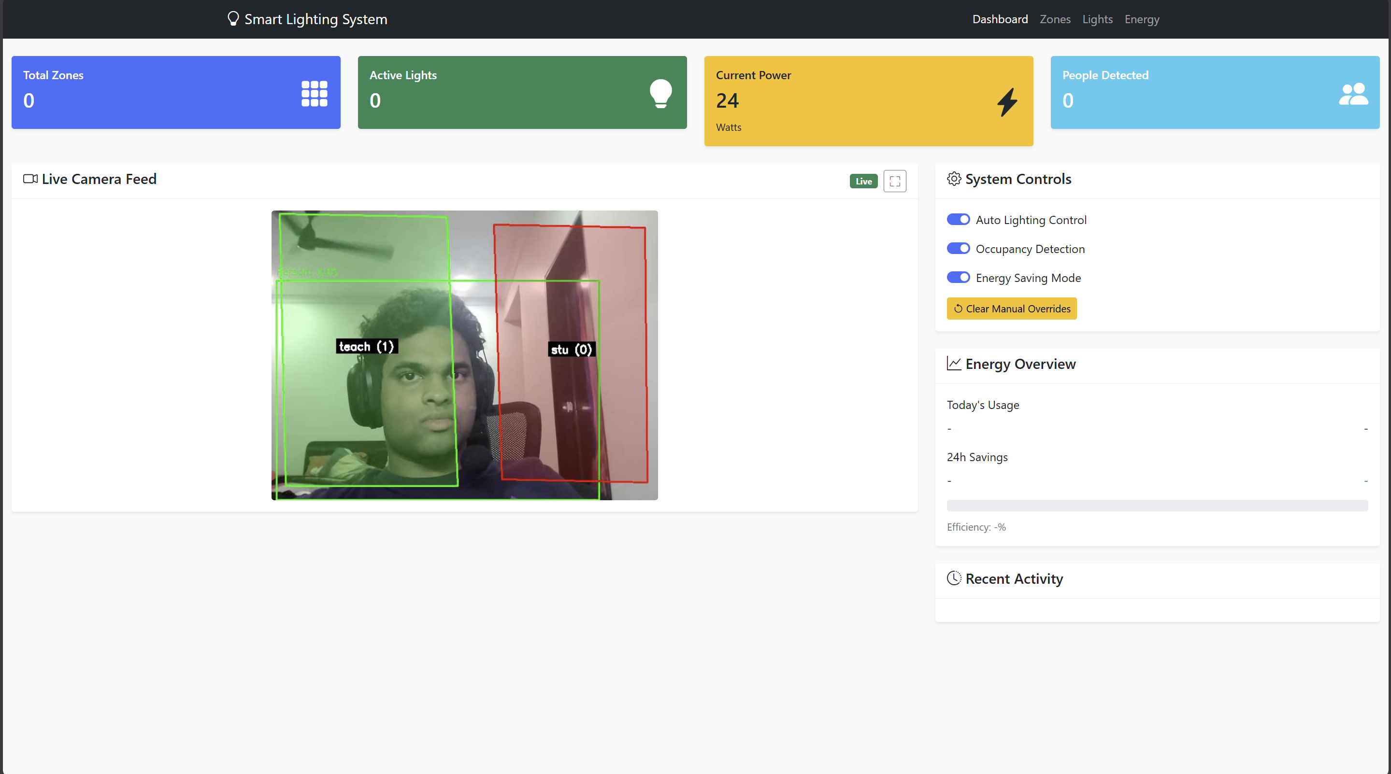
Implementation
Fig 1: Live Camera Feed page

Slide 13
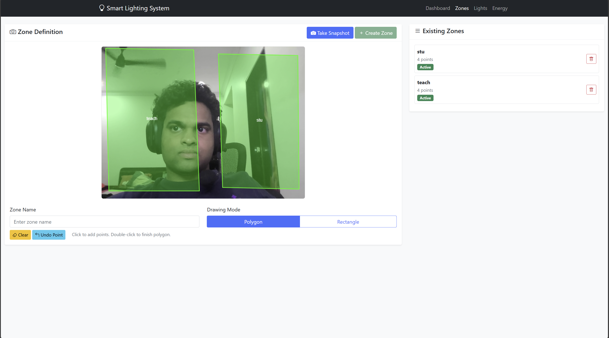
Implementation
Fig 2: Zone Definition page

Slide 14
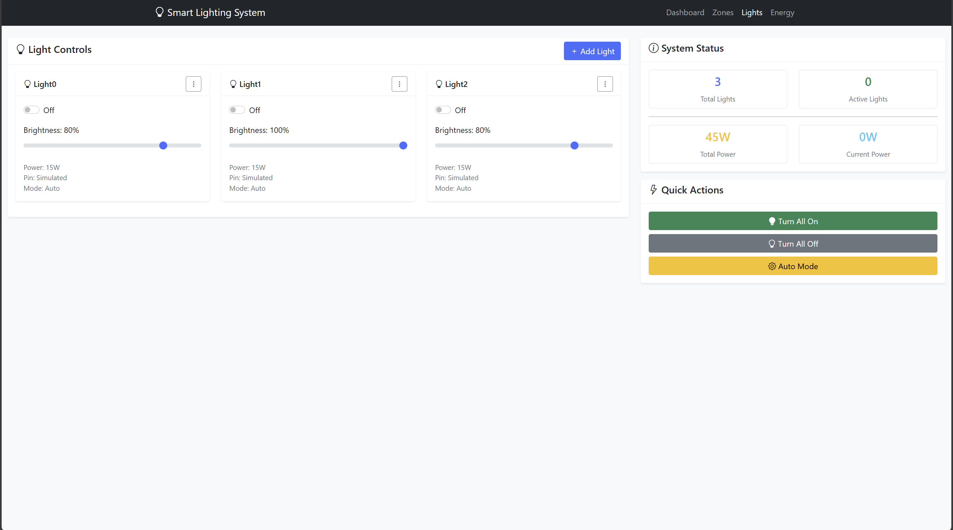
Implementation
Fig 3: Light Control page

Slide 15
Uniqueness
We compared our project with the research paper titled “Smart Lab Zonal Control” as our base paper.
Advanced ML-Based Human Detection Utilizes real-time computer vision models (e.g., YOLO, OpenCV) for precise presence detection, outperforming traditional PIR or rule-based systems.
Modular & Scalable Architecture Designed for flexible deployment across varied lab configurations, overcoming limitations of centralized or rigid setups.
Integrated Mobile Control Interface Offers remote monitoring and control via a dedicated mobile app, enhancing accessibility and user engagement.
Energy-Efficient LED Automation with Smart Dimming Combines intelligent lighting control with adaptive dimming to optimize energy savings beyond basic on/off automation.

Slide 16
Technologies Stack
1. Hardware Components
Raspberry Pi 5
Central controller and processing unit
Camera Module V3
Video capture for human detection
4-Channel Relay Module
Controls lighting circuits
LED Lighting System
Smart illumination control
2. Development
Mobile App Framework

Slide 17
Technologies Stack
3. Software Components
Programming
Python 3.x
Flask Web Framework
SQLite Database
4. Computer Vision
Open CV
TensorFlow lite
Yolo Detection Models
5. IoT Platform
Raspberry Pi OS
GPIO control Libraries
Wifi Conectivity

Slide 18





SDG Goal Alignment
7. Affordable and Clean Energy
35-70% reduction in lighting energy consumption through smart automation and efficient LED technology implementation.
9. Industry, Innovation and Infrastructure
Advanced IoT and ML implementation creating smart laboratory infrastructure with cutting-edge technology.
11. Sustainable Cities and Communities
Smart building systems improving safety, efficiency and sustainable resource management practices.
12. Responsible Consumption and Production
Elimination of energy waste through precise control and intelligent monitoring systems.
13. Climate Action
Significant reduction in carbon footprint and environmental impact through intelligent energy savings

Slide 19
Future Work
Multi-Sensor Fusion for Enhanced Accuracy Integrate thermal, ultrasonic, and ambient sensors alongside computer vision to improve human detection reliability in varied lighting and occupancy conditions.
Edge AI Optimization Deploy lightweight ML models (e.g., YOLO-Nano, MobileNet) for faster inference directly on Raspberry Pi, reducing cloud dependency and latency.
Adaptive Learning System Implement reinforcement learning to allow the system to adapt to user behavior and optimize energy usage dynamically over time.
Voice and Gesture-Based Control Add multimodal interfaces using voice commands and gesture recognition for hands-free lab interaction and accessibility.

Slide 20
References
.
Sakshi Y. Tupe et al., Sangram S. Kashid, Shreyash S. Jamdade, Shreyash S. Jadhav, and S.S. Ghatage, Computer Lab Automation System, IARJSET, Vol. 12, Special Issue 1, Article AITCON-14, 2025.
- K. Trikoupis et al., Remote Laboratory for IoT Development and Learning Analytics, arXiv, Article 2402.05466, 2024.
Mohankumar A. et al., Wireless Smart Lighting System, AJAST, Vol. 10, Article 8318, 2024.
Banagar A.N. et al., IoT-Based Smart Laboratory System, IJERT, Vol. 9, Issue 1, Article IJERTV9IS010178, 2023.
Al Shahrani A.M. et al., Machine Learning-Enabled Smart Industrial Automation Systems Using IoT Sensors, MDPI, Vol. 23, Issue 1, Article 324, 2023.

Slide 21
Rastogi A.K. et al., Internet of Things Enabled Machine Learning-Based Smart Systems: A Bird’s Eye View, Engineering Proceedings, MDPI, Vol. 59, Article 36, 2023.
Sudhakaran P. et al., A Secured Smart Automation System for Computer Labs in Engineering Colleges Using IoT, Computer Applications in Engineering Education, Wiley, Vol. 30, Issue 2, Article CAE.22226, 2022.
Raikwar A. et al., IoT-Based Smart Classroom Automation System, IJARIIE, Vol. 9, Issue 2, Article 26185, 2022.
Kulkarni T. et al., AI-Based Smart Lab Monitoring System, IJRASET, Vol. 10, Issue 12, Article 71868, 2021.
Prathima S. et al., Smart Lab with Automated Access, IJSMS, Vol. 3, Issue 3, Article IJSMS-V3I3P108, 2020.

Slide 22
Thank You...!!

